Slide 1
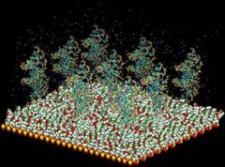
Dimension reduction :
PCA and Clustering
Slides by Agnieszka Juncker and Chris Workman

Slide 2
The DNA Array Analysis Pipeline
Question
Experimental Design
Array design
Probe design
Sample Preparation
Hybridization
Buy Chip/Array
Image analysis
Normalization
Expression Index
Calculation
Comparable
Gene Expression Data
Statistical Analysis
Fit to Model (time series)
Advanced Data Analysis
Clustering PCA Classification Promoter Analysis
Meta analysis Survival analysis Regulatory Network

Slide 3
Motivation: Multidimensional data
Pat1 Pat2 Pat3 Pat4 Pat5 Pat6 Pat7 Pat8 Pat9
209619_at 7758 4705 5342 7443 8747 4933 7950 5031 5293 7546
32541_at 280 387 392 238 385 329 337 163 225 288
206398_s_at 1050 835 1268 1723 1377 804 1846 1180 252 1512
219281_at 391 593 298 265 491 517 334 387 285 507
207857_at 1425 977 2027 1184 939 814 658 593 659 1318
211338_at 37 27 28 38 33 16 36 23 31 30
213539_at 124 197 454 116 162 113 97 97 160 149
221497_x_at 120 86 175 99 115 80 83 119 66 113
213958_at 179 225 449 174 185 203 186 185 157 215
210835_s_at 203 144 197 314 250 353 173 285 325 215
209199_s_at 758 1234 833 1449 769 1110 987 638 1133 1326
217979_at 570 563 972 796 869 494 673 1013 665 1568
201015_s_at 533 343 325 270 691 460 563 321 261 331
203332_s_at 649 354 494 554 710 455 748 392 418 505
204670_x_at 5577 3216 5323 4423 5771 3374 4328 3515 2072 3061
208788_at 648 327 1057 746 541 270 361 774 590 679
210784_x_at 142 151 144 173 148 145 131 146 147 119
204319_s_at 298 172 200 298 196 104 144 110 150 341
205049_s_at 3294 1351 2080 2066 3726 1396 2244 2142 1248 1974
202114_at 833 674 733 1298 862 371 886 501 734 1409
213792_s_at 646 375 370 436 738 497 546 406 376 442
203932_at 1977 1016 2436 1856 1917 822 1189 1092 623 2190
203963_at 97 63 77 136 85 74 91 61 66 92
203978_at 315 279 221 260 227 222 232 141 123 319
203753_at 1468 1105 381 1154 980 1419 1253 554 1045 481
204891_s_at 78 71 152 74 127 57 66 153 70 108
209365_s_at 472 519 365 349 756 528 637 828 720 273
209604_s_at 772 74 130 216 108 311 80 235 177 191
211005_at 49 58 129 70 56 77 61 61 75 72
219686_at 694 342 345 502 960 403 535 513 258 386
38521_at 775 604 305 563 542 543 725 587 406 906
217853_at 367 168 107 160 287 264 273 113 89 363
217028_at 4926 2667 3542 5163 4683 3281 4822 3978 2702 3977
201137_s_at 4733 2846 1834 5471 5079 2330 3345 1460 2317 3109
202284_s_at 600 1823 1657 1177 972 2303 1574 1731 1047 2054
201999_s_at 897 959 800 808 297 1014 998 663 491 613
221737_at 265 200 130 245 192 246 227 228 108 394
205456_at 63 64 100 60 82 65 53 73 71 81
201540_at 821 1296 1651 858 613 1144 1549 1462 1813 2112
219371_s_at 1477 2107 837 1534 2407 1104 1688 2956 1233 1313
205297_s_at 418 394 293 778 405 308 447 1005 709 201
208650_s_at 1025 455 685 872 718 884 534 863 219 846
210031_at 288 162 205 155 194 150 185 184 141 206
203675_at 268 388 318 256 413 279 239 246 1098 532
205255_x_at 677 308 679 540 398 447 428 333 197 417
202598_at 176 342 298 174 174 413 352 323 459 311
201022_s_at 251 193 116 106 155 285 221 242 377 217
218205_s_at 1028 1266 2085 1790 1096 2302 1925 1148 787 2700
207820_at 63 43 53 97 102 54 75 48 30 75
202207_at 77 217 241 67 441 318 474 83 72 130

Slide 4
Dimension reduction methods
Principal component analysis (PCA)
  Singular value decomposition (SVD)
Multidimensional scaling
Correspondence analysis
Cluster analysis
  Can be thought of as a dimensionality reduction method as clusters summarize data

Slide 5
Fundamental methods
Multidimensional scaling
  Rearranges objects so as to arrive at a configuration that best approximates the observed distances
Factor analysis (PCA, SVD)
  New vector space defined by variability in the data
Independent component analysis (ICA)
  In factor analysis, the similarities between objects are expressed in the correlation matrix. With MDS one may analyze any kind of similarity or dissimilarity matrix, in addition to correlation matrices.

Slide 6
Principal Component Analysis
(PCA)
Used for visualization of high-dimensional data
Projects high-dimensional data into a small number of dimensions
  Typically 2-3 principle component dimensions
Often captures much of the total data variation in a only few dimensions
Exact solutions require a fully determined system (matrix with full rank)
  i.e. A “square” matrix with independent entries

Slide 7
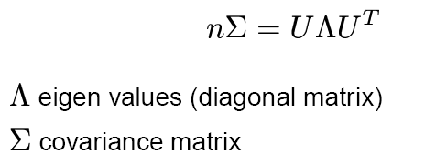
PCA

Slide 8
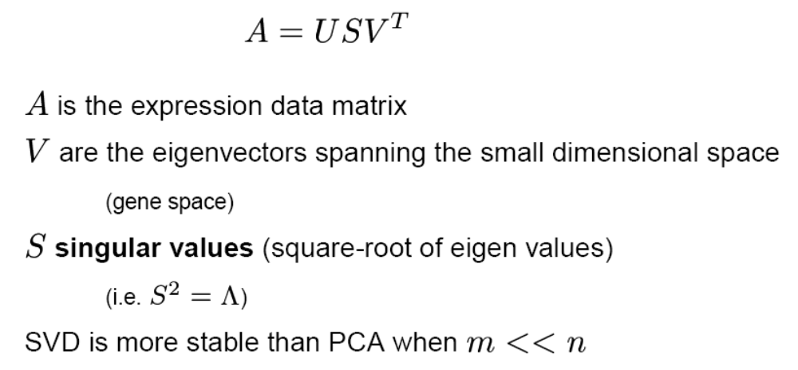
Singular Value Decomposition

Slide 9
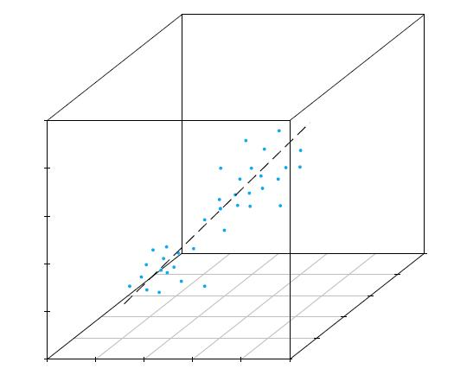
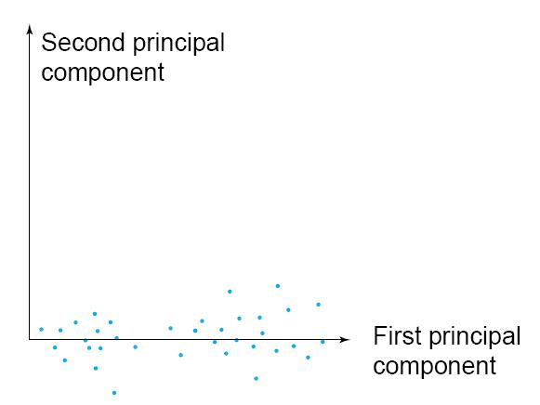
Principal components
1st Principal component (PC1)
  Direction along which there is greatest variation
2nd Principal component (PC2)
  Direction with maximum variation left in data, orthogonal to PC1

Slide 10
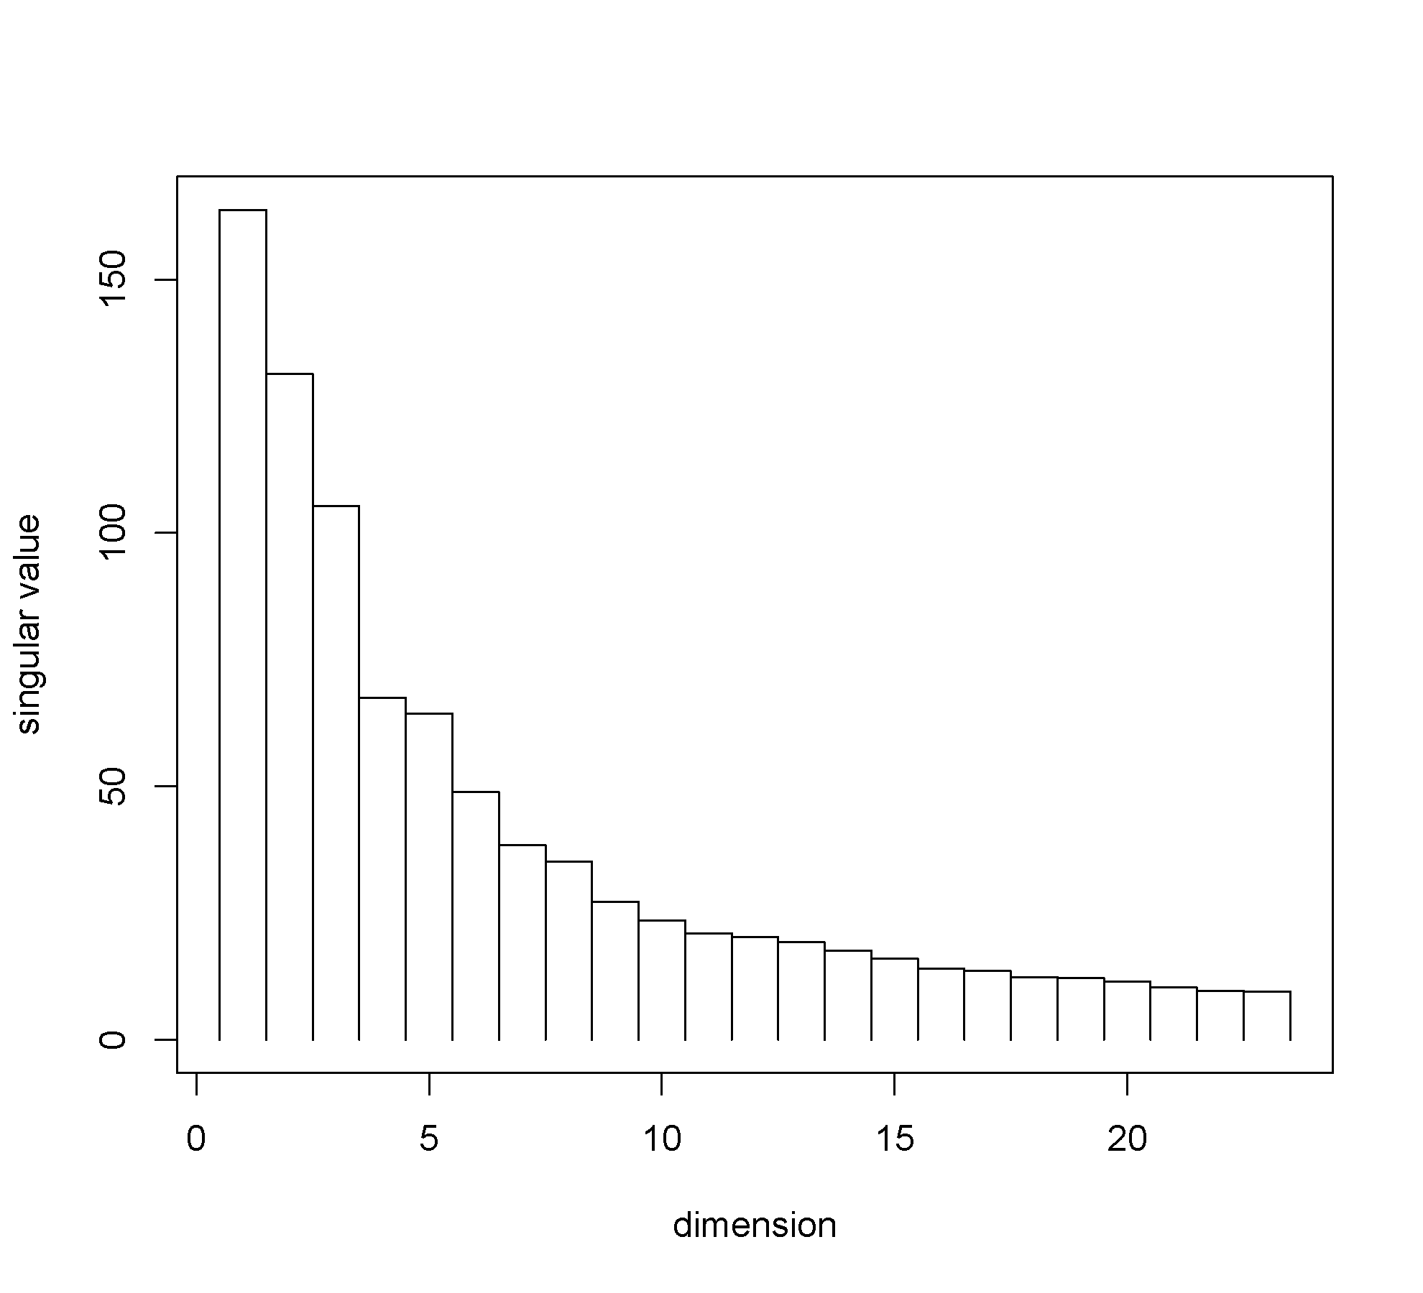
PCA: Eigen values
(variance by dimension)

Slide 11
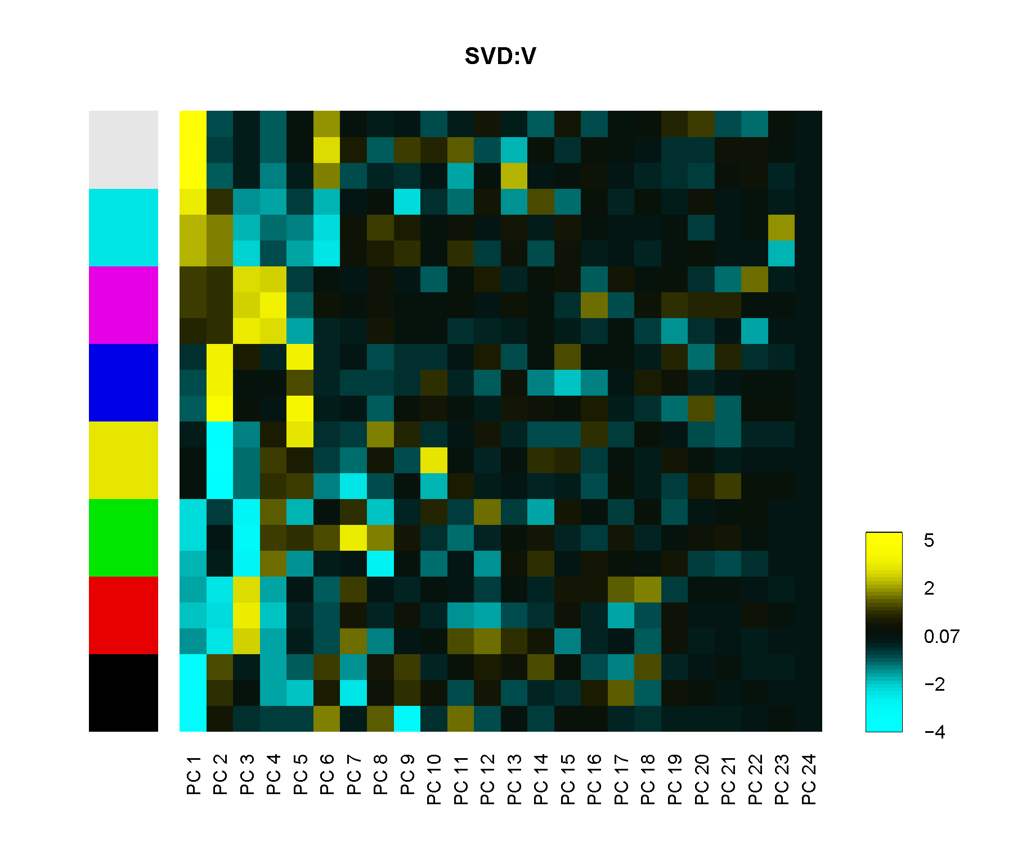
PCA Eigen vectors

Slide 12
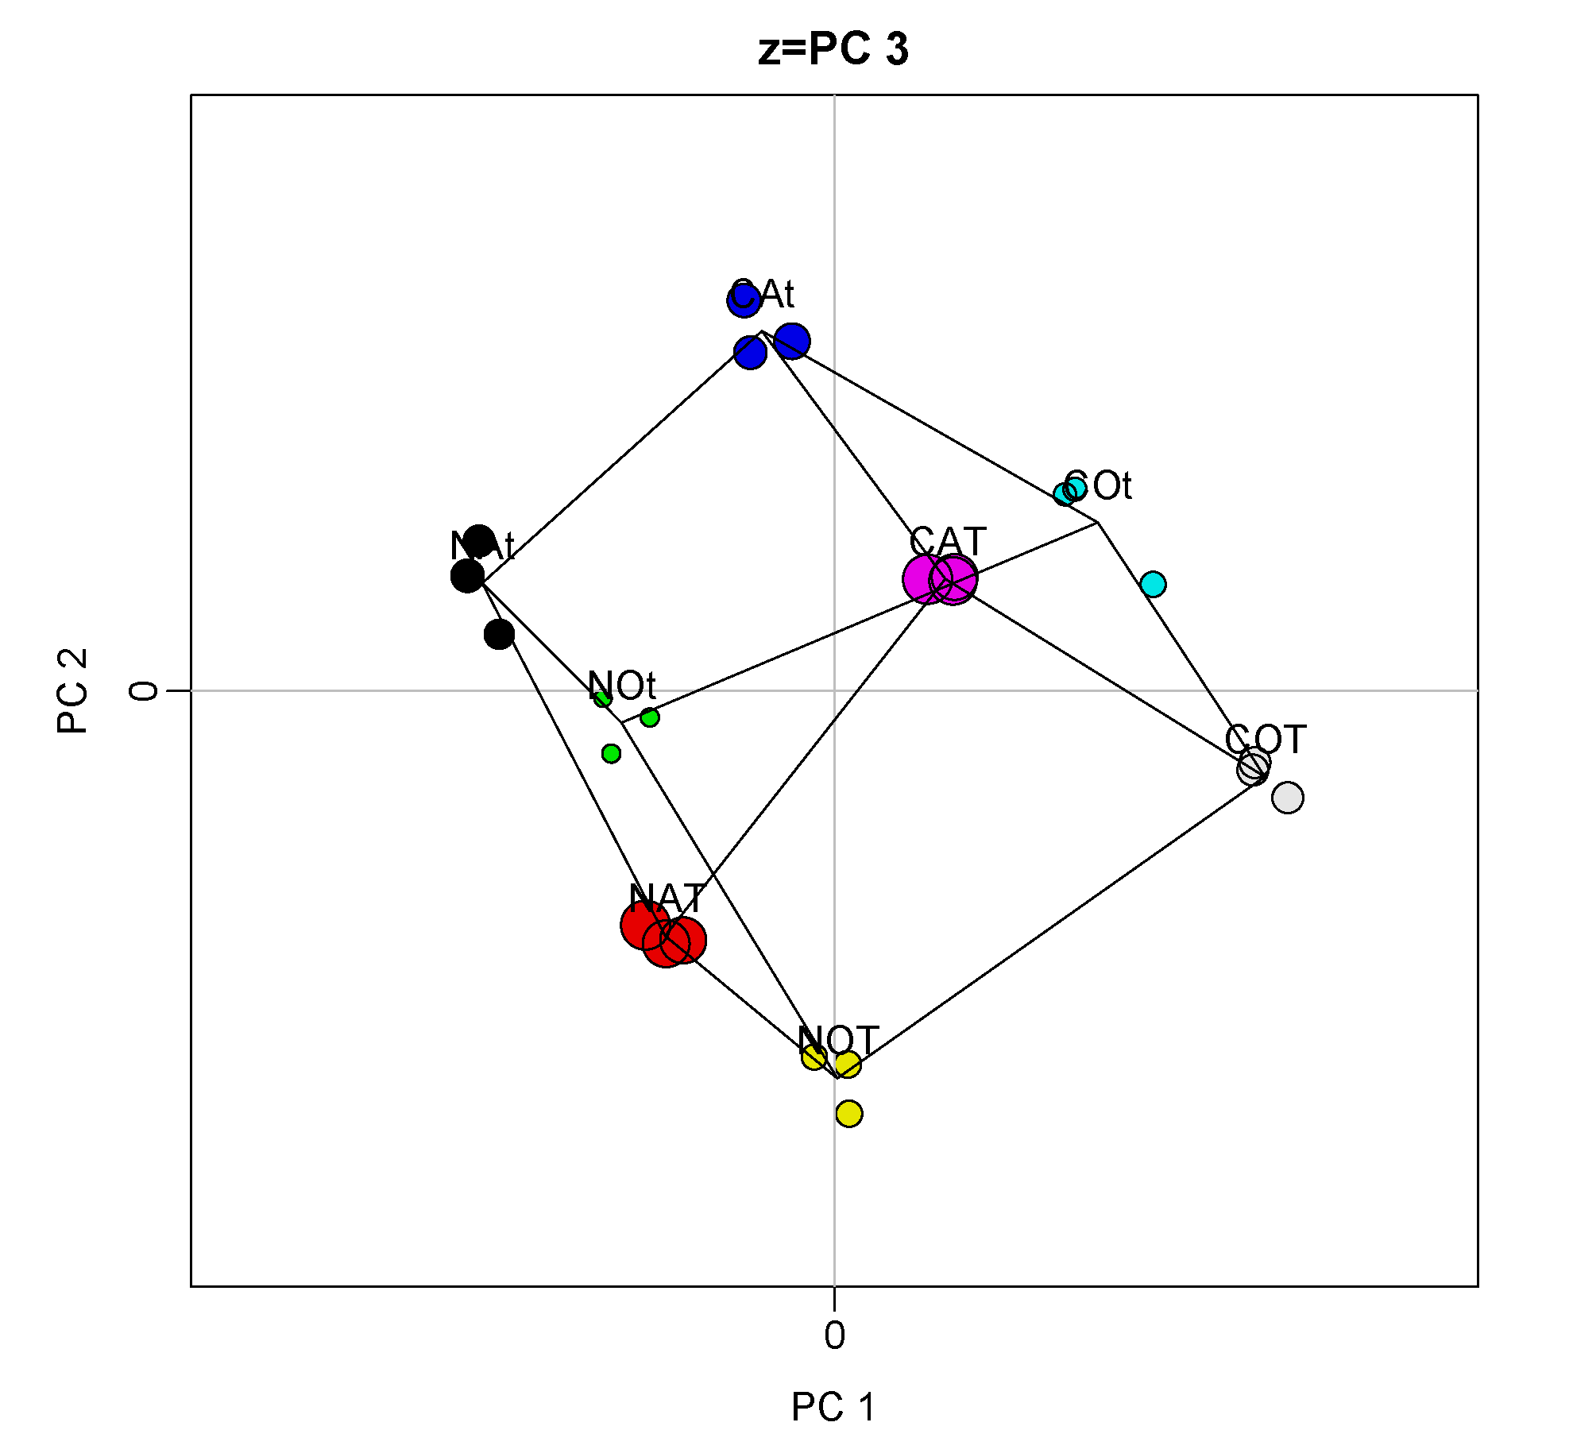
PCA projections (as XY-plot)

Slide 13
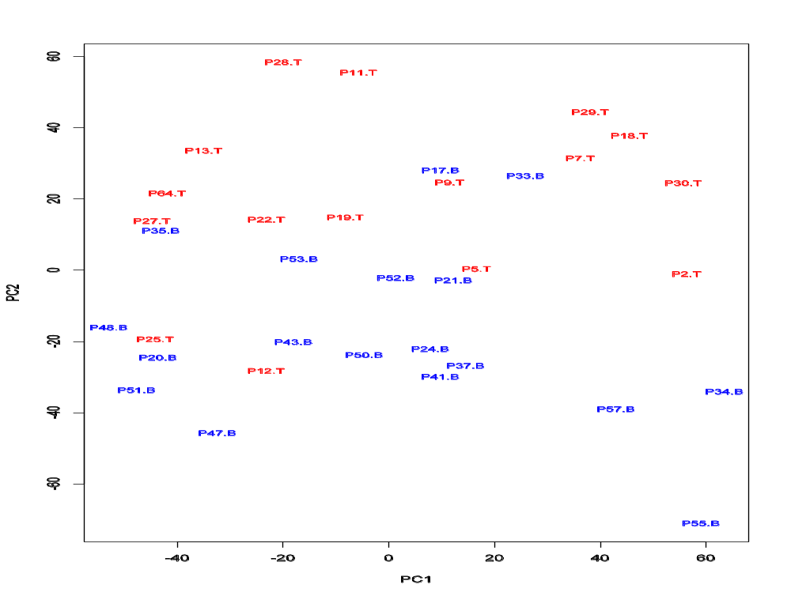
PCA: Leukemia data, precursor B and T
Plot of 34 patients, dimension of 8973 genes reduced to 2

Slide 14
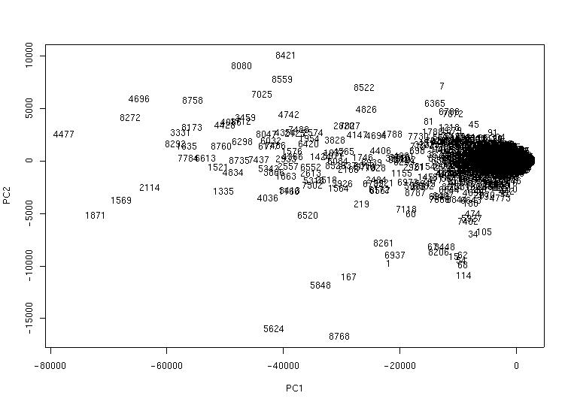
PCA of genes (Leukemia data)
Plot of 8973 genes, dimension of 34 patients reduced to 2

Slide 15
Why do we cluster?
Organize observed data into meaningful structures
Summarize large data sets
Used when we have no a priori hypotheses
Optimization:
  Minimize within cluster distances
  Maximize between cluster distances

Slide 16
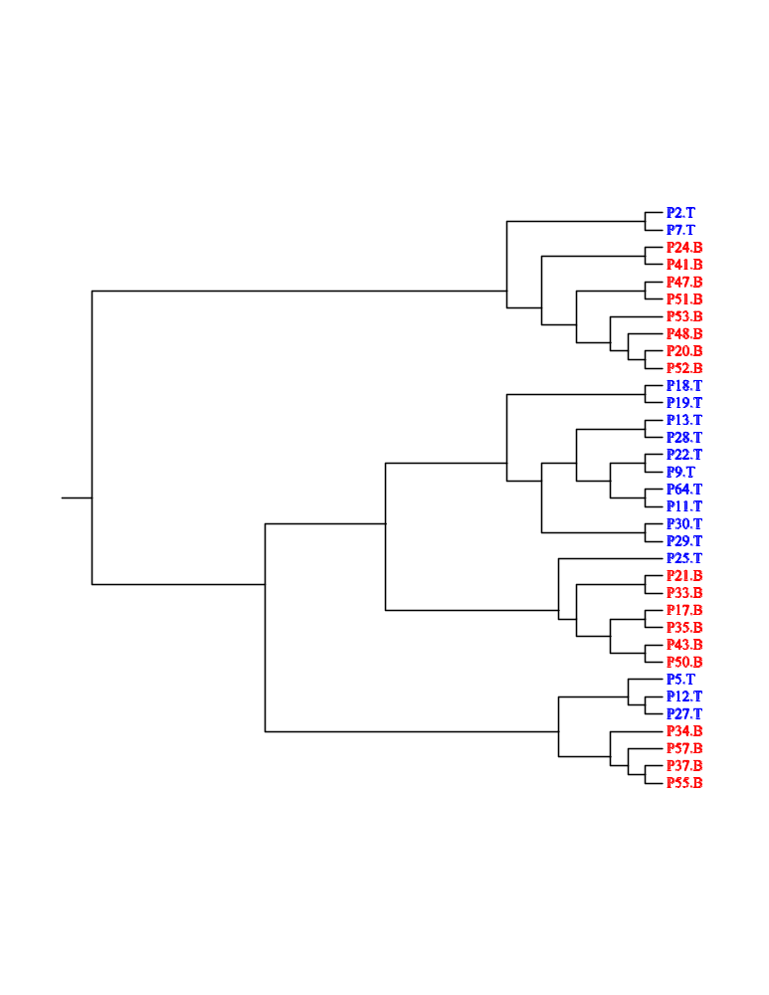
Many types of clustering methods
Method:
  K-class
  Hierarchical, e.g. UPGMA
    Agglomerative (bottom-up)
    Divisive (top-down)
  Graph theoretic
Information used:
  Supervised vs unsupervised
Final description of the items:
  Partitioning vs non-partitioning
  fuzzy, multi-class

Slide 17
Hierarchical clustering
Representation of all pair-wise distances
Parameters: none (distance measure)
Results:
  One large cluster
  Hierarchical tree (dendrogram)
Deterministic

Slide 18
Hierarchical clustering
– UPGMA Algorithm
Assign each item to its own cluster
Join the nearest clusters
Re-estimate the distance between clusters
Repeat for 1 to n

Slide 19
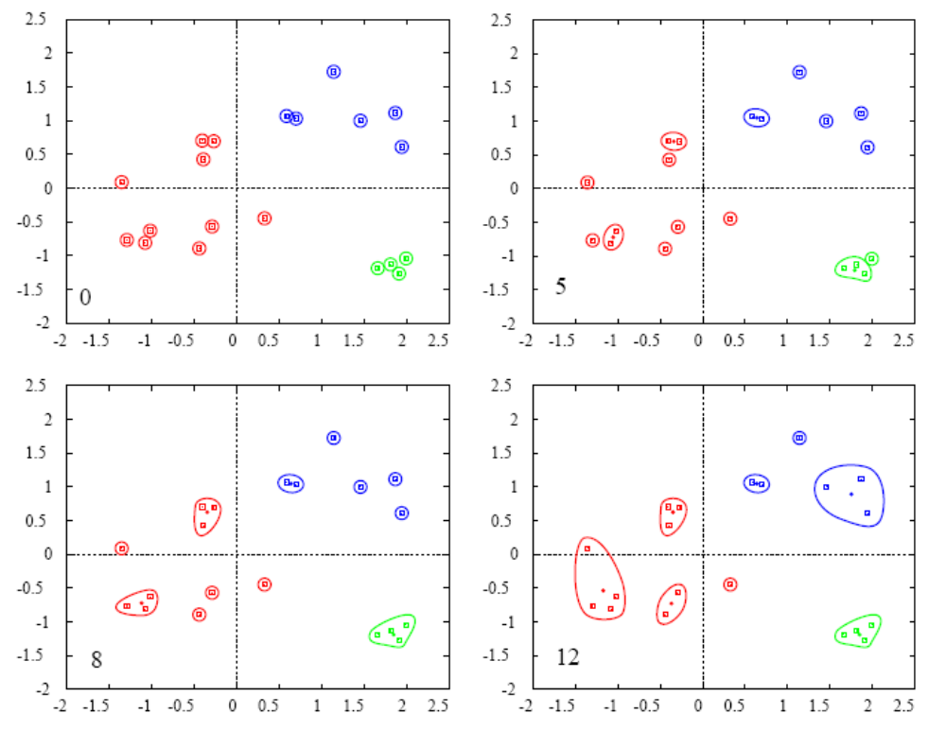
Hierarchical clustering

Slide 20
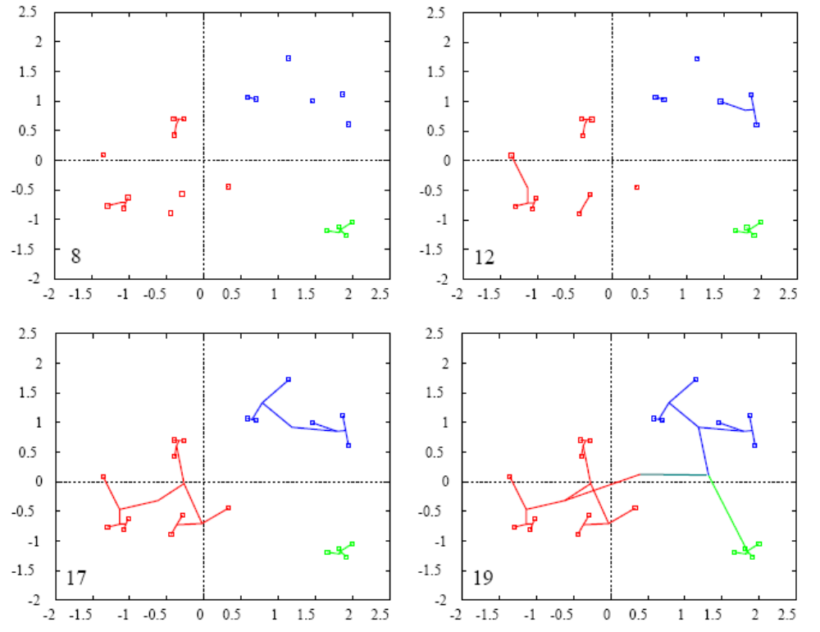
Hierarchical clustering

Slide 21
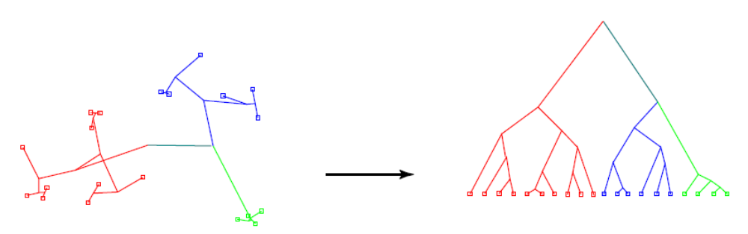
Hierarchical clustering
Data with clustering order
and distances
Dendrogram representation

Slide 22
Leukemia data - clustering of patients

Slide 23
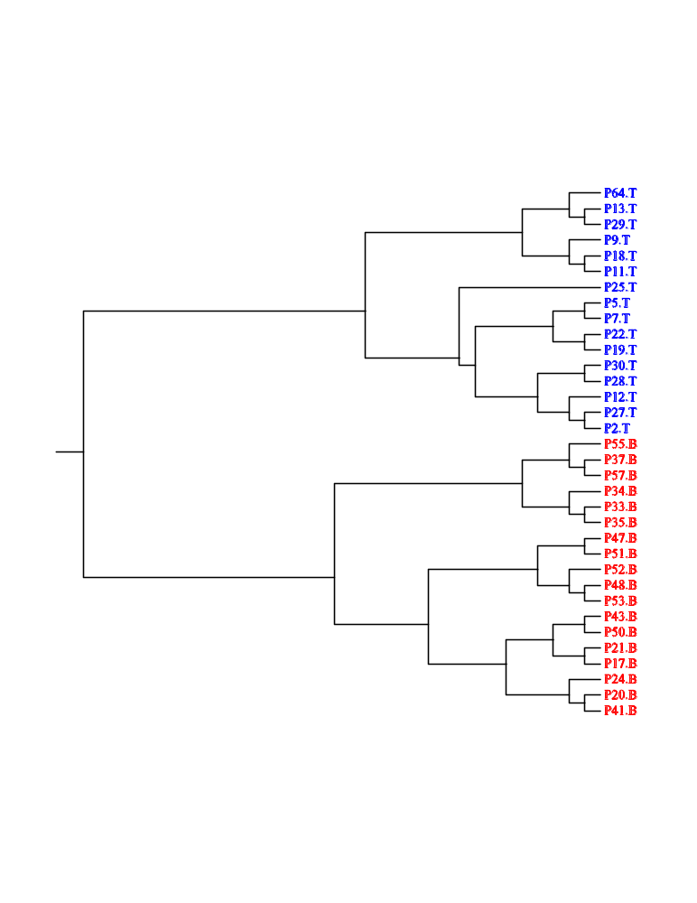
Leukemia data - clustering of patients on top 100 significant genes

Slide 24
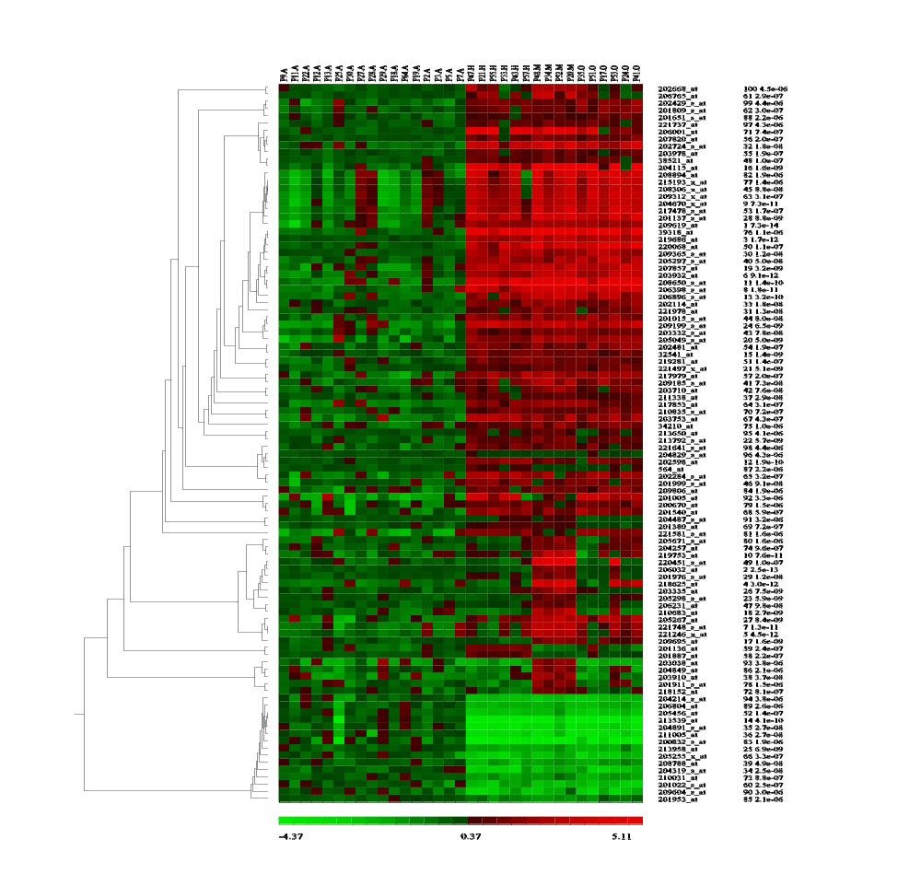
Leukemia data - clustering of genes

Slide 25
K-means clustering
Partition data into K clusters
Parameter: Number of clusters (K) must be chosen
Randomized initialization:
  Different clusters each time
  Non-deterministic

Slide 26
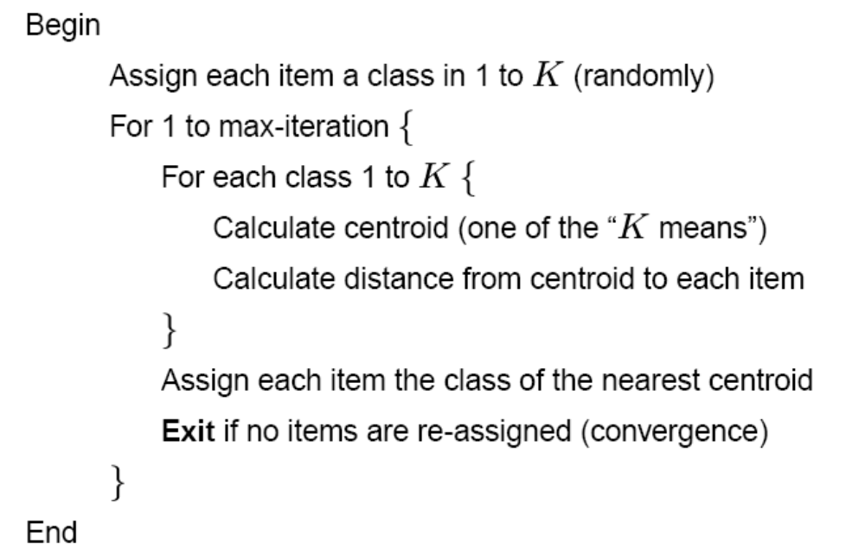
K-means - Algorithm

Slide 27
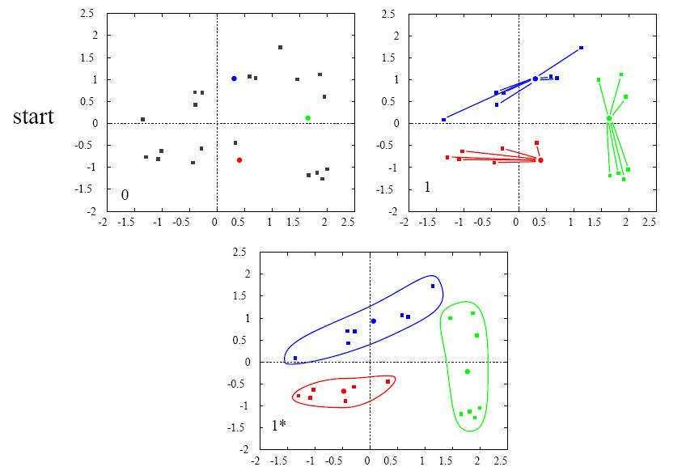
K-mean clustering, K=3

Slide 28
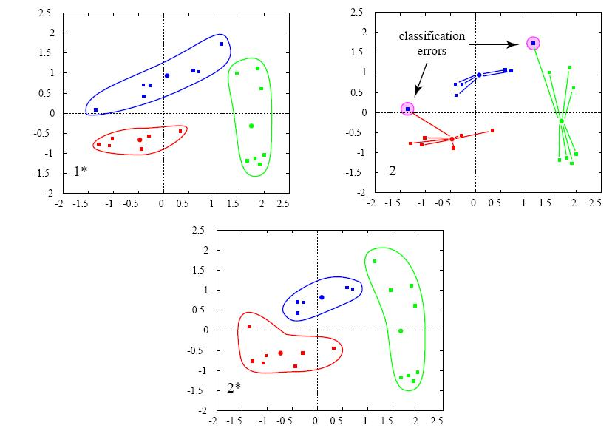
K-mean clustering, K=3

Slide 29
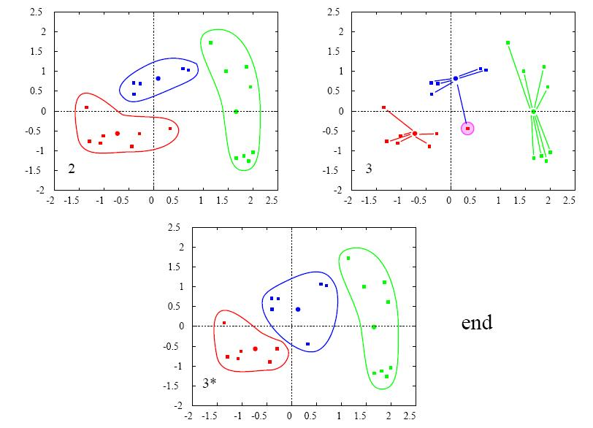
K-mean clustering, K=3

Slide 30
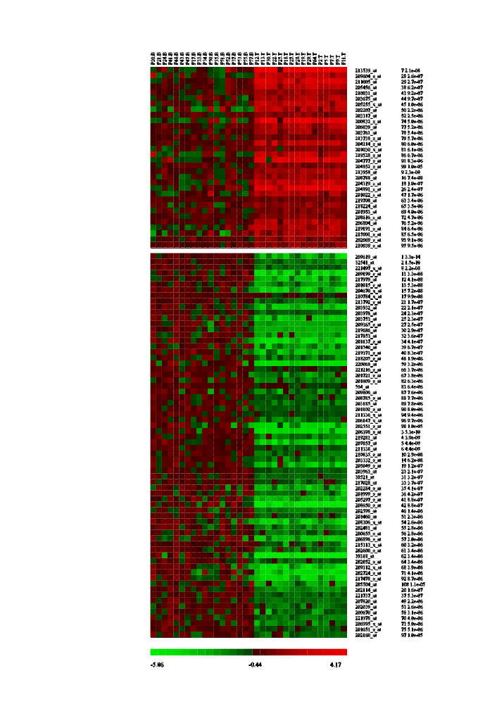
K-means clustering of Leukemia data

Slide 31
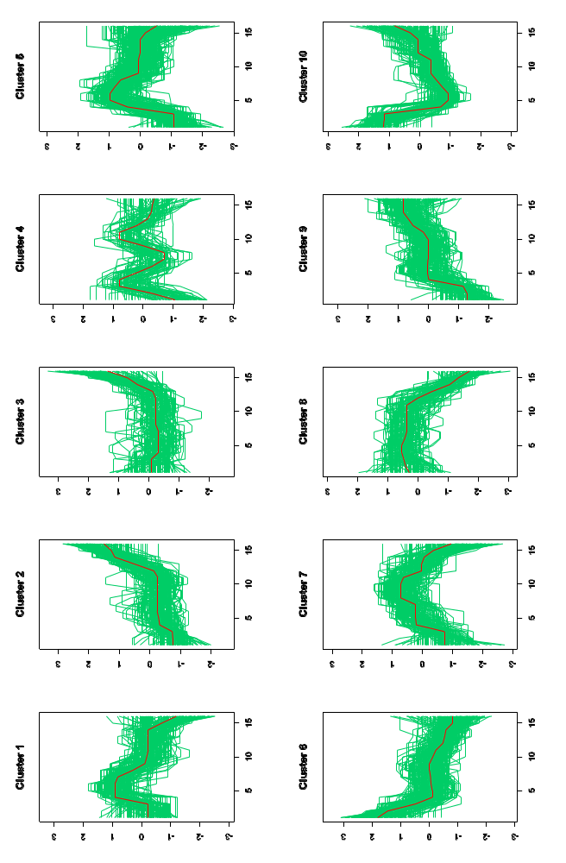
K-means clustering of Cell Cycle data

Slide 32
Self Organizing Maps (SOM)
Partitioning method
  (similar to the K-means method)
Clusters are organized in a two-dimensional grid
Size of grid is specified
  (eg. 2x2 or 3x3)
SOM algorithm finds the optimal organization of data in the grid

Slide 33
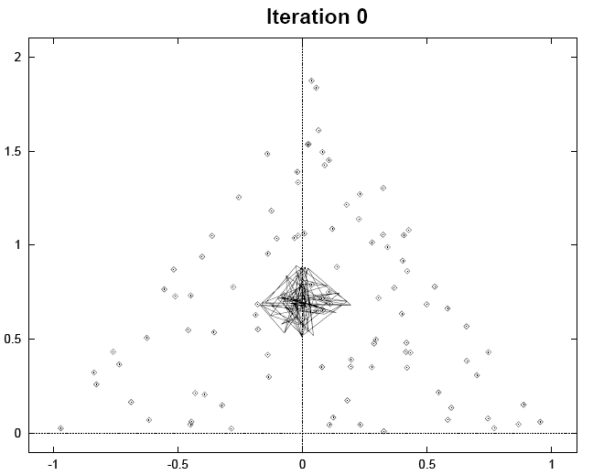
SOM - example

Slide 34
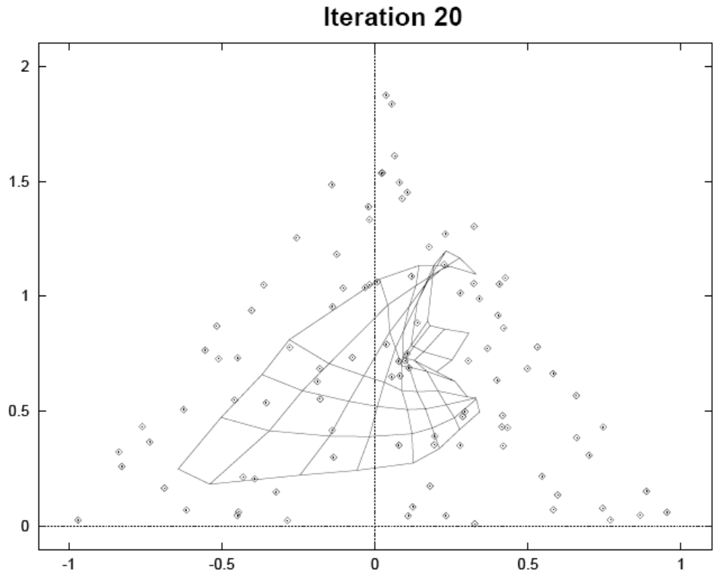
SOM - example

Slide 35
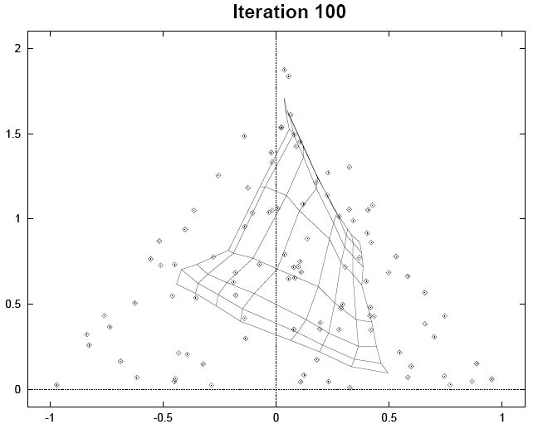
SOM - example

Slide 36
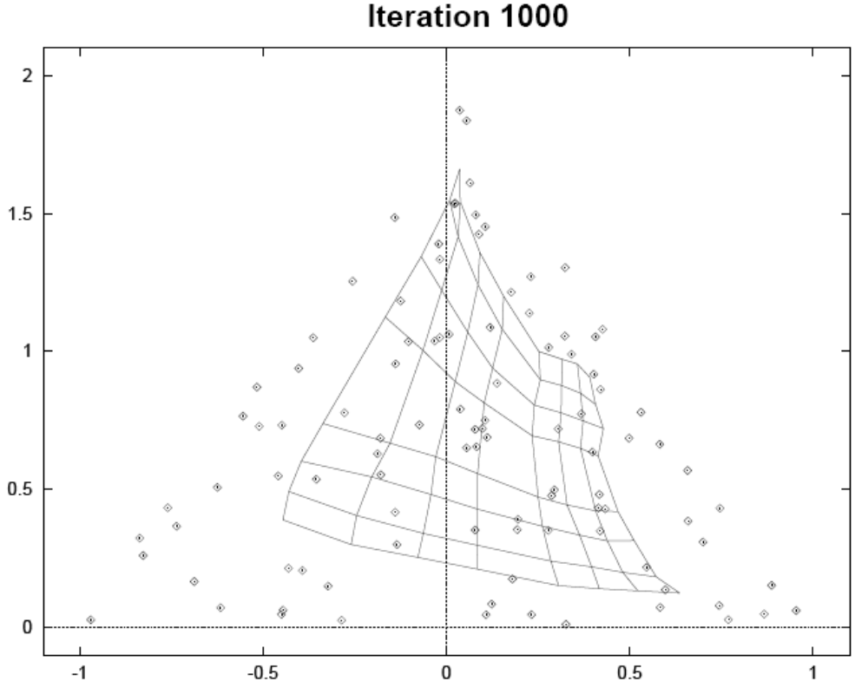
SOM - example

Slide 37
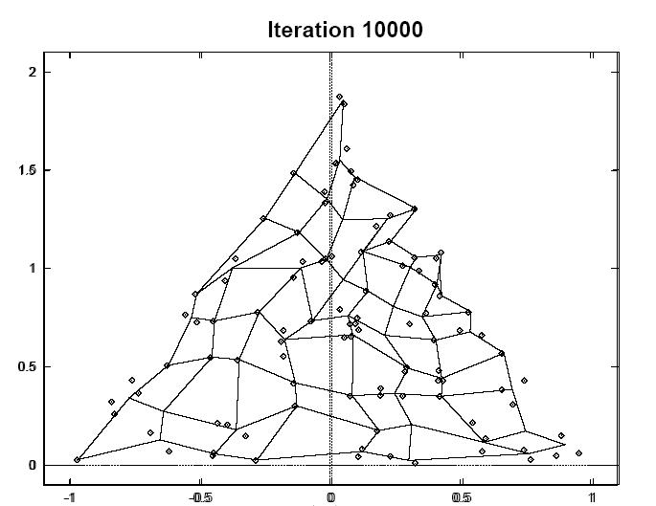
SOM - example

Slide 38
Comparison of clustering methods
Hierarchical clustering
  Distances between all variables
  Time consuming with a large number of gene
  Advantage to cluster on selected genes
K-means clustering
  Faster algorithm
  Does only show relations between all variables
SOM
  Machine learning algorithm

Slide 39
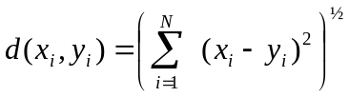

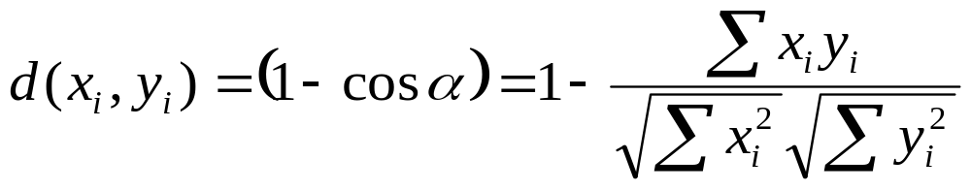

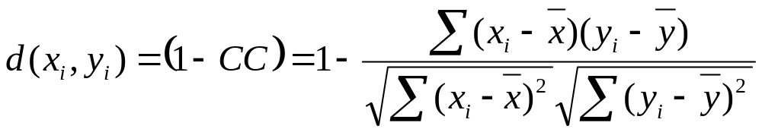
Distance measures
Euclidian distance
Vector angle distance
Pearsons distance

Slide 40
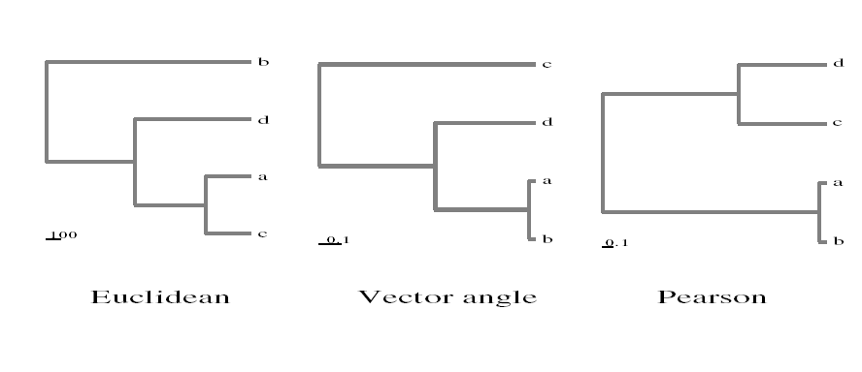
Comparison of distance measures

Slide 41
Summary
Dimension reduction important to visualize data
Methods:
  Principal Component Analysis
  Clustering
    Hierarchical
    K-means
    Self organizing maps
    (distance measure important)

